Slide 1
MATERIAL SCIENCE AND TECHNOLOGY
BY
Er.SISIRA KUMAR JAGADEV
Asst.Proffesor Mechanical Engineering
(M.Tech in Thermal Engineering,CUTM,Jatni,ODISHA)
(B.Tech in Mechanical Engineering,
Sophitorium Engineering College,Khordha,Odisha)

Slide 2
MODULE– I
THEORY OF METAL CUTTING
1.1 INTRODUCTION In an industry, metal components are made into different shapes and dimensions by using various metal working processes. Metal working processes are classified into two major groups.
They are:
• Non-cutting shaping or chips less or metal forming process - forging, rolling, pressing, etc.
• Cutting shaping or metal cutting or chip forming process - turning, drilling, milling, etc

Slide 3
MATERIAL REMOVAL PROCESSES
Definition of machining Machining is an essential process of finishing by which work pieces are produced to the desired dimensions and surface finish by gradually removing the excess material from the preformed blank in the form of chips with the help of cutting tool(s) moved past the work surface(s).
Principle of machining Fig. 1.1 typically illustrates the basic principle of machining. A metal rod of irregular shape, size and surface is converted into a finished product of desired dimension and surface finish by machining by proper relative motions of the tool-work pair,

Slide 4
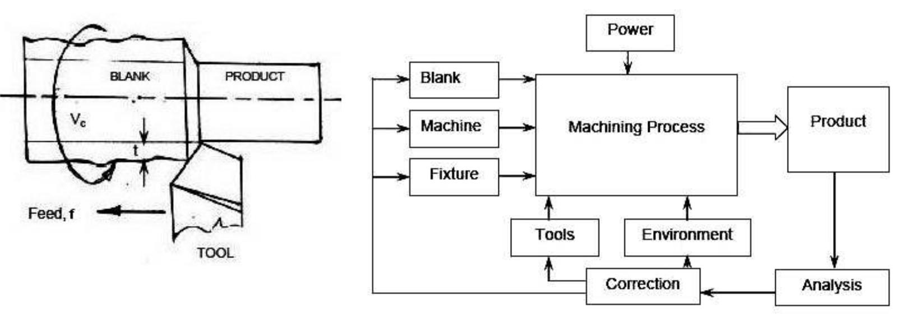
Fig. 1.1 Principle of machining (Turning) Fig. 1.2 Requirements for machining

Slide 5
Purpose of machining
Most of the engineering components such as gears, bearings, clutches, tools, screws and nuts etc. need
dimensional and form accuracy and good surface finish for serving their purposes. Performing like casting,forging etc. generally cannot provide the desired accuracy and finish. For that such preformed parts, calledblanks, need semi-finishing and finishing and it is done by machining and grinding. Grinding is also basicallya machining process.
Machining to high accuracy and finish essentially enables a product:
• Fulfill its functional requirements.
• Improve its performance.
• Prolong its service.

Slide 6
Requirements of machining
The essential basic requirements for machining a work are schematically illustrated in Fig. 1.2. Theblank and the cutting tool are properly mounted (in fixtures) and moved in a powerful device calledmachine tool enabling gradual removal of layer of material from the work surface resulting in itsdesired dimensions and surface finish. Additionally some environment called cutting fluid is generallyused to ease machining by cooling and lubrication.

Slide 7
TYPES OF MACHINE TOOLS
Definition of machine tool
A machine tool is a non-portable power operated and reasonably valued device or system of devices in whichenergy is expended to produce jobs of desired size, shape and surface finish by removing excess material fromthe preformed blanks in the form of chips with the help of cutting tools moved past the work surface(s).

Slide 8
Basic functions of machine tools
Machine tools basically produce geometrical surfaces like flat, cylindrical or any contour on the preformedblanks by machining work with the help of cutting tools.
The physical functions of a machine tool in machining are:
Firmly holding the blank and the tool.
Transmit motions to the tool and the blank.
Provide power to the tool-work pair for the machining action.
Control of the machining parameters, i.e., speed, feed and depth of cut.

Slide 9
Classification of machine tools
Number of types of machine tools gradually increased till mid 20th century and after that started decreasing based on group technology.
However, machine tools are broadly classified as follows:
According to direction of major axis:
Horizontal - center lathe, horizontal boring machine etc.
Vertical - vertical lathe, vertical axis milling machine etc.
Inclined - special (e.g. for transfer machines).

Slide 10
According to purpose of use:
• General purpose -e.g. center lathes, milling machines, drilling, machines etc.
• Single purpose - e.g. facing lathe, roll turning lathe etc.
• Special purpose - for mass production.
According to degree of automation:
• Non-automatic -e.g. center lathes, drilling machines etc.
• Semi-automatic - capstan lathe, turret lathe, hobbing machine etc.
• Automatic - e.g., single spindle automatic lathe, swiss type automatic lathe, CNC
• milling machine etc.

Slide 11
According to size:
• Heavy duty - e.g., heavy duty lathes (e.g. 55 kW), boring mills, planning machine, horizontal boringmachine etc.
• Medium duty -e.g., lathes - 3.7 ~ 11 kW, column drilling machines, milling machines etc.
• Small duty - e.g., table top lathes, drilling machines, milling machines.
• Micro duty - e.g., micro-drilling machine etc.
According to blank type:
• Bar type (lathes).
• Chucking type (lathes).
• Housing type.
According to precision:
• Ordinary - e.g., automatic lathes.
• High precision - e.g., Swiss type automatic lathes.
According to number of spindles:
• Single spindle - center lathes, capstan lathes, milling machines etc.
• Multi spindle - multi spindle (2 to 8) lathes, gang drilling machines etc.
According to type of automation:
• Fixed automation - e.g., single spindle and multi spindle lathes.
• Flexible automation - e.g., CNC milling machine.

Slide 12
According to configuration:
• Stand alone type - most of the conventional machine tools.
• Machining system (more versatile) - e.g., transfer machine, machining center, FMS etc

Slide 13
Specification of machine tools
A machine tool may have a large number of various features and characteristics. But only some
specific salient features are used for specifying a machine tool. All the manufacturers, traders and
users must know how machine tools are specified.
The methods of specification of some basic machine tools are as follows:

Slide 14
Centre lathe:
• Maximum diameter and length of the jobs that can be accommodated.
• Power of the main drive (motor).
• Range of spindle speeds and range of feeds.
• Space occupied by the machine.
Shaper:
• Length, breadth and depth of the bed.
• Maximum axial travel of the bed and vertical travel of the bed / tool.
• Maximum length of the stroke (of the ram / tool).
• Range of number of strokes per minute.
• Range of table feed.
• Power of the main drive.
• Space occupied by the machine.

Slide 15
Drilling machine (column type):
• Maximum drill size (diameter) that can be used.
• Size and taper of the hole in the spindle.
• Range of spindle speeds.
• Range of feeds.
• Power of the main drive.
• Range of the axial travel of the spindle / bed.
• Floor space occupied by the machine.
Milling machine (knee type and with arbor):
• Type; ordinary or swiveling bed type.
• Size of the work table.
• Range of travels of the table in X - Y - Z directions.
• Arbor size (diameter).
• Power of the main drive.
• Range of spindle speed.
• Range of table feeds in X - Y - Z directions.
• Floor space occupied.

Slide 16
THEORY OF METAL CUTTING
Types of cutting tools
Cutting tools may be classified according to the number of major cutting edges (points) involved as follows:
•Single point: e.g., turning tools, shaping, planning and slotting tools and boring tools.
•Double (two) point: e.g., drills.
• Multipoint (more than two): e.g., milling cutters, broaching tools, hobs, gear shaping cutters etc.

Slide 17
CLASSIFICATION OF CUTTING TOOLS
All the cutting tools used in metal cutting can be broadly classified as :
1.Single point cutting tools ,i.e., those having only one cutting edge; such as late tools, shaper tools , plannertools etc.
2.Multi –point cutting tools ,i.e., those having more than one cutting edges; such as milling cutters, drills,broaches, grinding wheels, etc. those tools for shake of analysis ,be considered as consisting of a numbers ofsingle point cutting tools ,each forming a cutting edges.
The cutting tools can also be classified according to the motion as :
a) Linear motion tools –lathe, boring, broaching, planing etc.
b) Rotary motion tools-milling cutters, grinding wheels, etc.
c) Both linear and rotary tools-drills, honing tools etc.

Slide 18
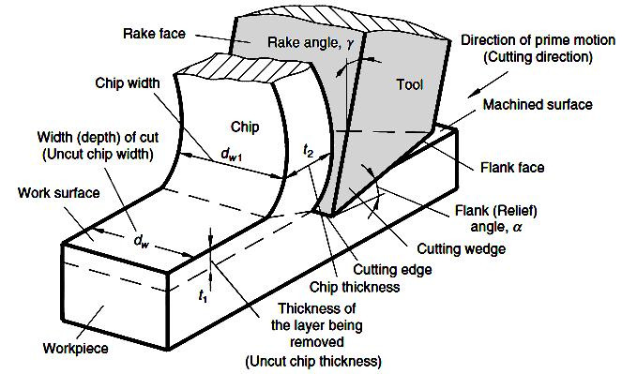
IMPORTANTS TERMS REGADING SINGLE POINT CUTTING TOOL

Slide 19
The single point cutting tool mainly consist of tool shank & cutting part called point. The point of cutting tool
is bounded by cutting face, end flank, side/ main flank, & base. The chip slide along the face. The side / main
cutting edge ‘ab’ is formed by intersecting of face & side / main flank The end cutting edge ‘ac’ is formed by
the intersection of end flank & base. The point ‘a’ which the intersection of end cutting edge & side cutting
edge is called nose Mainly the chip cuts by side cutting edge.

Slide 20
Parts of a single point cutting tool: slides.
1. Shank – It is main body of tool. The shank used to grip in tool holder.
2. Flank – The surface or surface below the adjacent of the cutting edge is called flank of the tool.
3. Face – It is top surface of the tool along which the chips
4. Base – It is actually a bearing surface of the tool when it is held in tool holder or clamped directly in atool post.
5. Heel – It is the intersection of the flank & base of the tool. It is curved portion at the bottom of the tool.
6. Nose radius – It is the point where side cutting edge & base cutting edge intersect.
7. Noise radius –It provide long life & good surface finish sharp cutting tip is weak.The nose of a tool is slightly rounded in all turning tools.

Slide 21
The function of nose radius is as follows:
Greater nose radius clears up the feed marks caused by the previous shearing action and provides bettersurface finish.
All finish turning tool have greater nose radius than rough turning tools.
It increases the strength of the cutting edge, tends to minimize the wear taking place in a sharp pointed tool
with consequent increase in tool life.
Accumulation heat is less than that in a pointed tool which permits higher cutting speeds.

Slide 22
8. Cutting edge – It is the edge on face of the tool which removes the material from workpiece . The cutting edges are side cutting edge (major cutting edge) & end cutting edge ( minor cutting edge)A single point cutting tool may be either right-or left hand cut tool depending on the direction of feed.

Slide 23
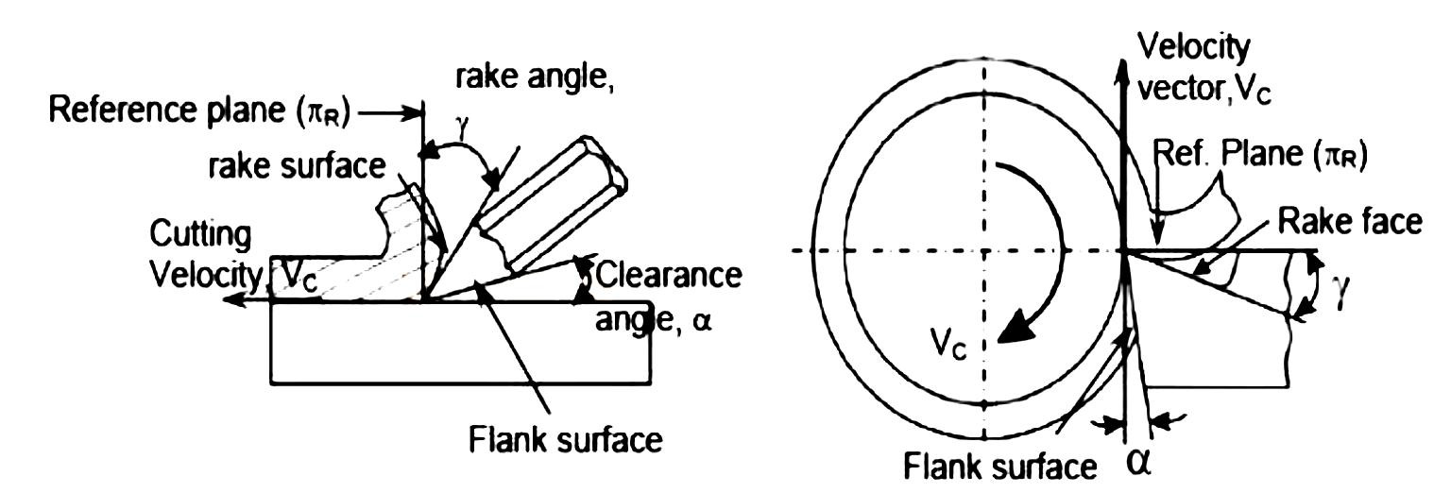
CONCEPT OF RAKE AND CLEARANCE ANGLES OF CUTTING TOOLS
The word tool geometry is basically referred to some specific angles or slope of the salient faces and edges of the tools at their cutting point. Rake angle and clearance angle are the most significant for all the cutting tools.
T he concept of rake angle and clearance angle will be clear from some simple operations shown in Fig.
Rake and clearance angles of cutting tools

Slide 24
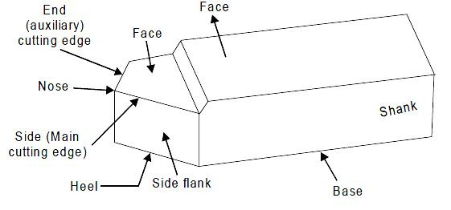
DESCRIPTION OF TOOL GEOMETRY IN MACHINE REFERENCE SYSTEM
This system is also called as ASA system; ASA stands for American Standards Association. Geometry of a cutting tool refers mainly to its several angles or slopes of its salient working surfaces and cutting edges.
Those angles are expressed with respect to some planes of reference. In Machine Reference System (ASA), the three planes of reference and the coordinates are chosen based on the configuration and axes of the machine tool concerned. The planes and axes used for expressing tool geometry in ASA system for turning o peration are shown in Fig.

Slide 25
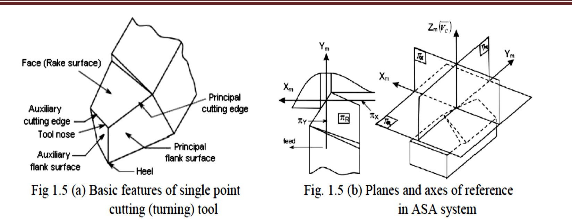

Slide 26
Types of chips
Different types of chips of various shape, size, colour etc. are produced by machining Depending upon:
• Type of cut, i.e., continuous (turning, boring etc.) or intermittent cut (milling).
• Work material (brittle or ductile etc.).
• Cutting tool geometry (rake, cutting angles etc.).
• Levels of the cutting velocity and feed (low, medium or high).
• Cutting fluid (type of fluid and method of application).

Slide 27
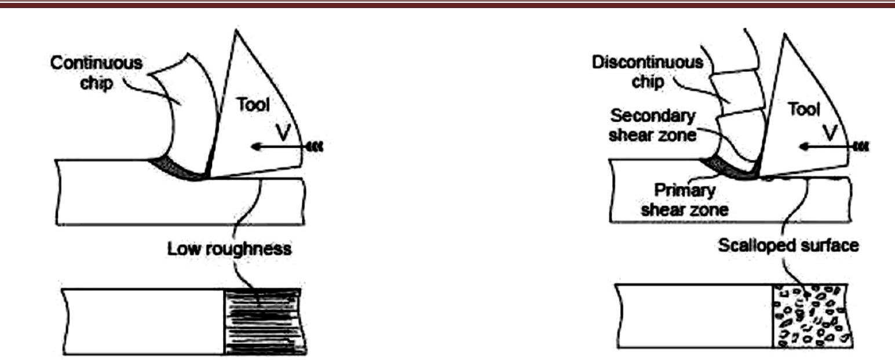

Slide 28
Forced chip-breaking
The hot continuous chip becomes hard and brittle at a distance from its origin due to work hardening and
cooling. If the running chip does not become enough curled and work hardened, it may not break. In that case
the running chip is forced to bend or closely curl so that it breaks into pieces at regular intervals. Such broken
chips are of regular size and shape depending upon the configuration of the chip breaker. Chip breakers are
basically of two types:
• In-built type.
• Clamped or attachment type.
I n-built breakers are in the form of step or groove at the rake surface near the cutting edges of the tools.
Such chip breakers are provided either:
• After their manufacture - in case of HSS tools like drills, milling cutters, broaches etc and brazed type
carbide inserts.
• During their manufacture by powder metallurgical process - e.g., throw away type inserts of carbides,
ceramics and cermets.The basic principle of forced chip breaking is schematically shown in Fig. 1.28. When the strain hardened andbrittle running chip strikes the heel, the cantilever chip gets forcibly bent and then breaks.

Slide 29
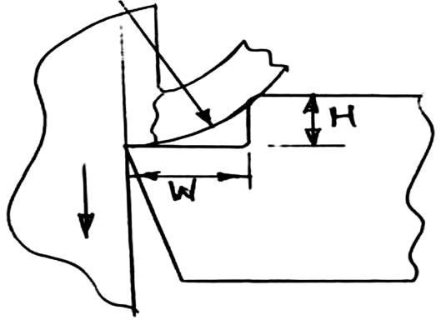
W = width, H = height, = shear angle
F ig. 1.28 Principle of forced chip breaking

Slide 30
MODULE -2
ORTHOGONAL METAL CUTTING
Benefit of knowing and purpose of determining cutting forces
The aspects of the cutting forces concerned:
Magnitude of the cutting forces and their components.
Directions and locations of action of those forces.
Pattern of the forces: static and / or dynamic.
Knowing or determination of the cutting forces facilitate or are required for:
Estimation of cutting power consumption, which also enables selection of the powerSource(s) during design of the machine tools. Structural design of the machine - fixture - tool system.
Evaluation of role of the various machining parameters (process - VC, fo, t, tool - material And geometry, environment - cutting fluid) on cutting forces.
Study of behavior and mach inability characterization of the work materials.
Condition monitoring of the cutting tools and machine tools.

Slide 31
MODULE -2
CUTTING TOOL MATERIALS
Essential properties of cutting tool materials
The cutting tools need to be capable to meet the growing demands for higher productivity and economy as
well as to machine the exotic materials which are coming up with the rapid progress in science and
technology. The cutting tool material of the day and future essentially require the following properties to
resist or retard the phenomena leading to random or early tool failure:

Slide 32
High mechanical strength; compressive, tensile, and TRA.
Fracture toughness - high or at least adequate.
High hardness for abrasion resistance.
High hot hardness to resist plastic deformation and reduce wear rate at elevated temperature.
Chemical stability or inertness against work material, atmospheric gases and cutting fluids.
Resistance to adhesion and diffusion.
Thermal conductivity - low at the surface to resist incoming of heat and high at the core to quickly dissipate the heatentered.
High heat resistance and stiffness.
Manufacturability, availability and low cost

Slide 33
TOOL WEAR
Failure of cutting tools
Smooth, safe and economic machining necessitates:
Prevention of premature and terrible failure of the cutting tools.
Reduction of rate of wear of tool to prolong its life.
To accomplish the aforesaid objectives one should first know why and how the cutting tools fail.
Cutting tools generally fail by:
Mechanical breakage due to excessive forces and shocks. Such kind of tool failure is random and catastrophic in nature and hence is extremely detrimental.
Quick dulling by plastic deformation due to intensive stresses and temperature. This type of failure also occurs rapidly and is quite detrimental and unwanted.
Gradual wear of the cutting tool at its flanks and rake surface.

Slide 34
Mechanical wear
Thermally insensitive type; like abrasion, chipping and de-lamination.
Thermally sensitive type; like adhesion, fracturing, flaking etc.
Flank wear is a flat portion worn behind the cutting edge which eliminates some clearance or relief. It takesplace when machining brittle materials. Wear at the tool-chip interface occurs in the form of a depression orcrater. It is caused by the pressure of the chip as it slides up the face of the cutting tool. Both flank and craterwear take place when feed is greater than 0.15 mm/rev at low or moderate speeds.

Slide 35
Thermo chemical wear
Macro-diffusion by mass dissolution.
Micro-diffusion by atomic migration.
In diffusion wear the material from the tool at its rubbing surfaces, particularly at the rake surface gradually diffuses into the flowing chips either in bulk or atom by atom when the tool material has chemical affinity or solid solubility towards the work material. The rate of such tool wears increases with the increase in temperature at the cutting zone. This wear becomes predominant when the cutting temperature becomes very high due to high cutting velocity and high strength of the work material.

Slide 36
Chemical wear
Chemical wear, leading to damages like grooving wear may occur if the tool material is not enough chemically stable against the work material and/or the atmospheric gases.
Galvanic wear
Galvanic wear, based on electrochemical dissolution, seldom occurs when the work and tool materials areelectrically conductive, cutting zone temperature is high and the cutting fluid acts as an electrolyte.
The usual pattern or geometry of wear of face milling inserts, turning tools and turninginserts are typically shown

Slide 37
Pure orthogonal cutting
This refers to chip flow along o and = 90 as typically shown in Fig. 1.9. Where a pipe like job of uniformthickness is turned (reduced in length) in a center lathe by a turning tool of geometry; = 0and = 90resulting chip flow along o which is also x in this case.

Slide 38
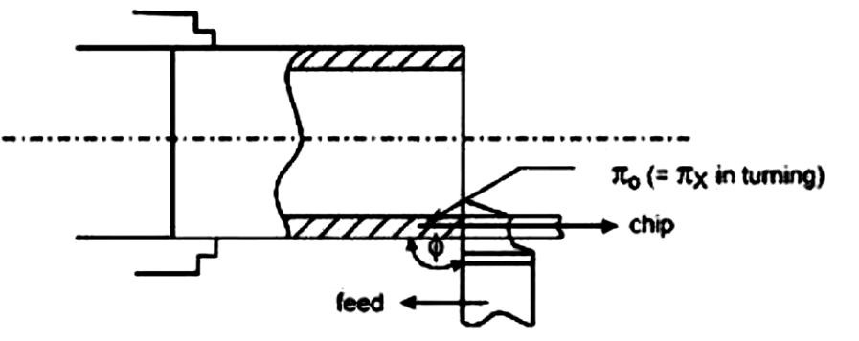
Pure orthogonal cutting (pipe turning)

Slide 39
CUTTING TOOL MATERIALS
Essential properties of cutting tool materials
The cutting tools need to be capable to meet the growing demands for higher productivity and economy as well as to machine the exotic materials which are coming up with the rapid progress in science and technology. The cutting tool material of the day and future essentially require the following properties toresist or retard the phenomena leading to random or early tool failure:

Slide 40
High mechanical strength; compressive, tensile, and TRA.
Fracture toughness - high or at least adequate.
High hardness for abrasion resistance.
High hot hardness to resist plastic deformation and reduce wear rate at elevated temperature.
Chemical stability or inertness against work material, atmospheric gases and cutting fluids.
Resistance to adhesion and diffusion.
Thermal conductivity - low at the surface to resist incoming of heat and high at the core to quickly dissipate the heat
entered.
High heat resistance and stiffness.
Manufacturability, availability and low cost

Slide 41
TOOL WEAR
Failure of cutting tools
Smooth, safe and economic machining necessitates:
Prevention of premature and terrible failure of the cutting tools.
Reduction of rate of wear of tool to prolong its life.
To accomplish the aforesaid objectives one should first know why and how the cutting tools fail.

Slide 42
Cutting tools generally fail by:
Mechanical breakage due to excessive forces and shocks. Such kind of tool failure is random and
catastrophic in nature and hence is extremely detrimental.
Quick dulling by plastic deformation due to intensive stresses and temperature. This type of failure
also occurs rapidly and is quite detrimental and unwanted.
Gradual wear of the cutting tool at its flanks and rake surface.
The first two modes of tool failure are very harmful not only for the tool but also for the job and the machine
tool. Hence these kinds of tool failure need to be prevented by using suitable tool materials and geometry
depending upon the work material and cutting condition.
But failure by gradual wear, which is inevitable, cannot be prevented but can be slowed down only to enhance
the service life of the tool. The cutting tool is withdrawn immediately after it fails or, if possible, just before it
totally fails. For that one must understand that the tool has failed or is going to fail shortly.

Slide 43
Scribing Templates
These are used to defi ne the areas for exposure to CD. The most common scribing method is to cut the maskwith a sharp knife, followed by careful peeling. The EF allowance must be included. 4. Accessories These include tanks, hooks, brackets, racks, and fixtures.
Process parameters CHM process parameters include the reagent solution type, concentration, properties,mixing, operating temperature, and circulation. The process is also affected by the maskant and its application. These parameters will have direct impacts on the workpiece regarding the following:

Slide 44
Advantages
• Weight reduction is possible on complex contours that are diffi cult to machine conventionally.
• Several parts can be machined simultaneously.
• Simultaneous material removal from all surfaces, improves productivity and reduces wrapping.
• No burr formation.
• No induced stresses, thus minimizing distortion and enabling machining of delicate parts.
• Low capital cost of equipment, and minor tooling cost.
• Quick implementation of design changes.
• Less skilled operator is needed.
• Low scrap rate.

Slide 45
1. Etch factor (d/T )
2. Etching and machining rate
3. Production tolerance
4. Surface finish
To machine high-quality and low-cost parts using CHM, we must consider the heat treatment state of theworkpiece, the grain size and range of the workpiece material, the size and finish control prior to CHM, the direction of rollin and weld joints, and the degree of cold work. Advantages and Disadvantages of Chemical Milling

Slide 46
Disadvantages
• Only shallow cuts are practical. Deep narrow cuts are diffi cult to produce.
• Handling and disposal of etchants can be troublesome.
• Masking, scribing, and stripping are repetitive, time-consuming, and tedious.
• Surface imperfections, if any, are reproduced.
• For best results, metallurgical homogeneous surfaces are required.
• Porous castings yield uneven etched surfaces.
• Welded zones are frequently etched at rates that differ from base metal.

Slide 47
ELECTRIC DISCHARGE MACHINING (EDM)
Electric Discharge Machining (EDM) is a chipless metal removal process that uses the principle of metalerosion by an interrupted electric spark discharge between the tool (cathode) and the work (anode). Thisprocess is also called Spark Erosion process. Principle of Operation We know that whenever an arc is caused by accidental short circuit, pitting erosion occurs on the surface of the shorted material. EDM also works on
the same principle of erosion by arcing. This principle is illustrated in Fig

Slide 48
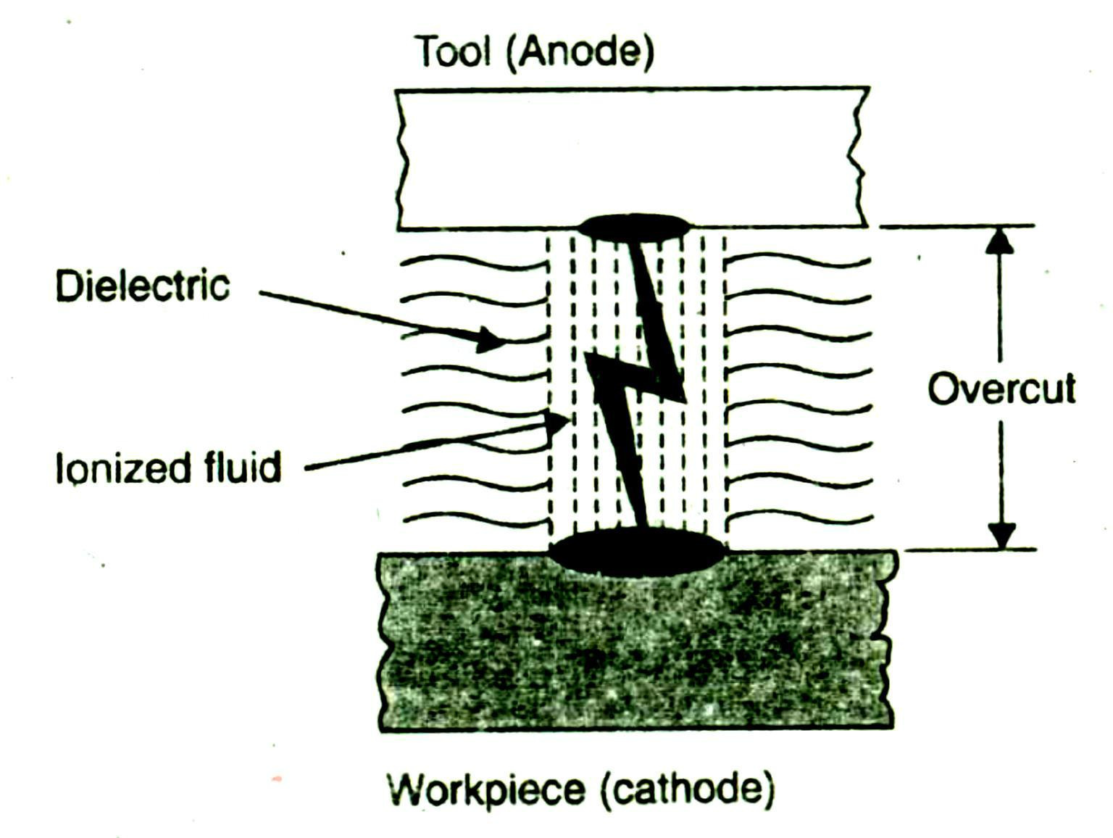

Slide 49
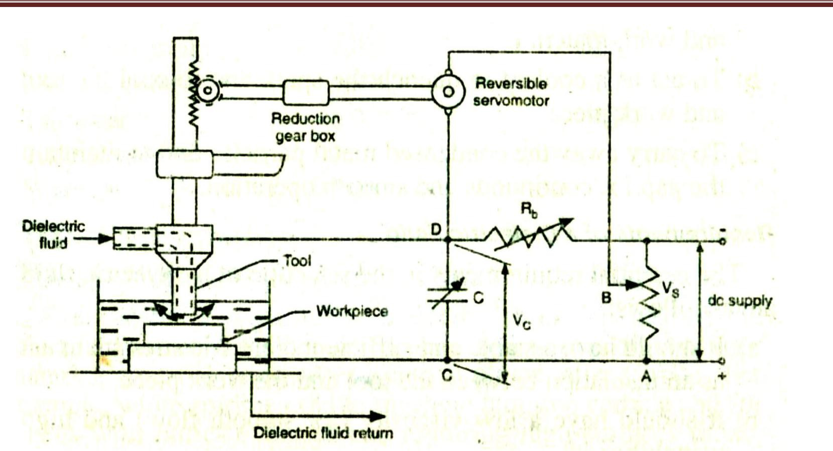
Electric discharge Setup

Slide 50
Functions of Dielectric Fluids
Functions of Dielectric Fluids
The functions of a dielectric fluid in EDM are as follows:
1 . to serve as a spark conductor in the spark gap between the tool and work material.
2. To act as a coolant to quench the spark and to cool the tool and work piece.
3. To carry away the condensed metal particles and to maintain the gap for continuous and smooth operation.

Slide 51
Requirements of a Dielectric Fluid The essential requirements in the selection of a dielectric fluid are as follows:
1. It should have a stable and sufficient dielectric strength to act as an insulation between the tool and the work piece.
2. It should have a low viscosity (for smooth flow) and high wettability.
3. It should be chemically inert, so that the tool, work piece, container, etc., are not attacked.
4. It should be able to de ionise immediately after the spark discharge.
5. It should have a high flash point.
6. It should not emit toxic vapours and should not have unpleasant odours.

Slide 52
7. It should not alter its basic properties under operating conditions of temperature variations, contamination by metal particles and products of decomposition.
8 . It should be economical for use. Flushing of the dielectric plays a major role in the maintenance of stable machining and the achievement of close tolerance and high surface quality. Inadequate flushing can result in arcing, decreased electrode life, and increased production time. Four methods of introducing dielectric fluid to the machining gap are considered. Normal flow. This is the most common type of flow pattern used. In this, the fluid is forced through holes in the electrodes (Fig. 3), which then flows out through the gap between the tool and the work piece. Since the gaps are of the order of 0.025 to 0.075 mm, it requires sufficient pressure and low viscosity fluids. The fluid pressure ranges from 1.5 to 2 bars. The main advantage of this type of flushing is that the fluid cools the work 7. It should not alter its basic properties under operating conditions of temperature variations, contamination by metal particles and products of decomposition.

Slide 53
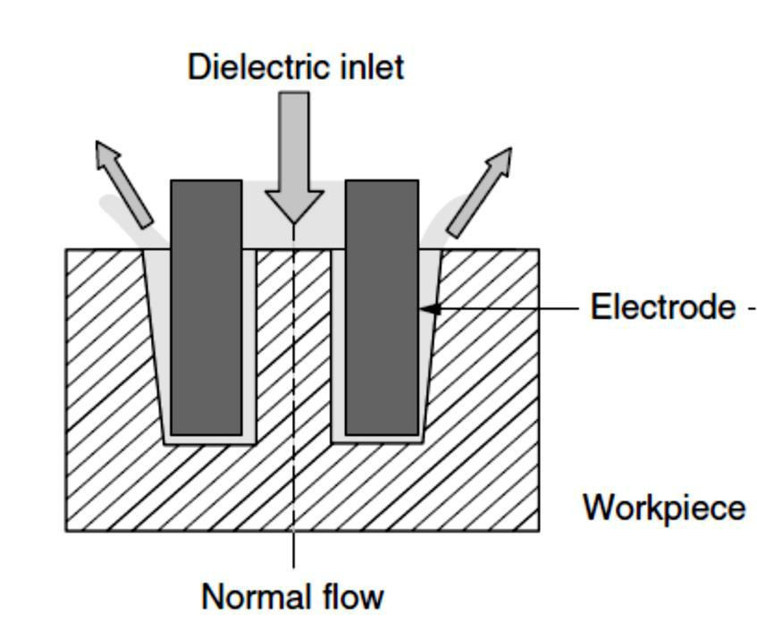
Normal flow of DEF

Slide 54
Reverse flow. This is another pressure flushing technique, in which the fluid flows through a predrilled hole
in the work piece, from its bottom . This method also works well as far as work piece cooling and
particle removal are concerned, but produces a large taper at the top as shown figure. Vacuum (suction) flow flushing In this method, the fluid is sucked through the work piece or through a
opening in the tool . There is no taper effect in this, but spike effect exists when sucked through the
tool. The spike effect can be eliminated by sucking through a opening in the work piece (similar to reverse
flow flushing, but with the use of vacuum). Vacuum pressures of the order of 0.8 bar are used for flushing.
This method is widely used for machining perfectly straight holes to greater depths.Prepared By

Slide 55
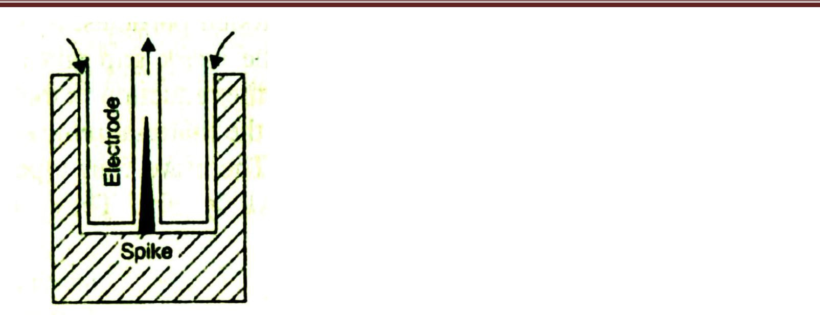
Vacuum flow suction

Slide 56
Vibratory flushing This method of flushing is used for very small diameter openings and for tools which
cannot provide a fluid passage. The tool is designed to vibrate so that the fluid adjacent to it flows through
the openings . This is used for highly precision and small works.

Slide 57
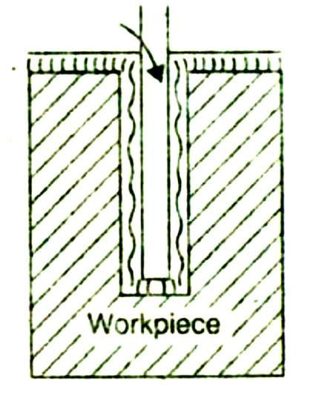
Vibratory flushing

Slide 58
Process variables in EDM
The important process variables in EDM are as follows:
1) Metal Removal Rate It is directly proportional to the current density used. It is defined as the volume of
metal removed per unit time per ampere. The metal removal rate in roughing operations of steel with a
graphite electrode 50A current is about 400 mm3/min., and with 400A current it is about 4800 mm3/min.
But for high precision works, with the use of high frequency (500-1000 kHz) and low current (1-2A), metal
removal rate is as low as 2 mm3/min.
2) Accuracy The accuracy of the process mainly depends on the spark gap. The smaller the gap the higher is
the accuracy, but a smaller gap leads to a lower working voltage and hence a slow metal removal rate. Thus,
an optimum gap is necessary for higher accuracies. Tolerances of ±O.O5 mm can be obtained in normal
EDM operations. In precision operations, with close control of process variables, tolerances up to ±0.003
mm can be achieved. EDM also produces taper, overcut and corner radii, which are not desirable. The taper
is of the order of 0.005 to 0.05 mm per 10 mm depth. The taper, effect reduces gradually to zero after about
75 mm penetration. Taper effect can be eliminated by the use of vacuum flushing of dielectric fluid.
The range of over cut is 5 to 100 microns, and depends on the roughing and finishing operations. The effect
of corner radii is equal to the spark gap. Its value is lower in finishing operations, - where low park gaps are
used.

Slide 59
3) Surface Finish In EDM operation, each electrical spark discharge develops a spherical crater in the work piece, as well as in the electrode. The volume of crater is proportional to the energy in the spark. Thus, the depth of crater on work piece defines the surface finish and it depends on the current density, frequency and the electrode material. Usually high frequency and low current densities give , better surface finish. The best surface finish on steel is of the order of 0.4 μrn (at 1000 kHz & lA). In a typical no-wear EDM, the surface finish is about 3.2 μrn (generally for roughing operations).

Slide 60
Heat Affected Zone (HAZ) The instant heating and vapourisation of metal due to spark, leaves behind a small amount of molten metal on the machined surface which resolidifies and due to fast cooling action of the dielectric fluid forms a hard surface. This becomes the Heat Affected Zone (HAZ) in EDM operation. The HAZ is about 2 to 10 μrn deep on the work surface and its hardness is about 60 HRc. This hard surface is a source for thermal stresses, plastic deformation and fine cracks at the grain boundaries. The depth of 'HAZ is small in finishing operations which can be removed by polishing after EDM operation. Applications It is useful for machining of hard and brittle materials. It is generally used for machining contours in tools anddies for extrusion, forging, pressing, etc. It can be used to machine refractory metals, hard carbides and high strength the tool steels.

Slide 61
MODULE-3
Machining of spheres. simple tubular electrodes in the EDM machining of convex and concave spheres, to a dimensional accuracy of ±1 μm and a surface roughness of less than 0.1 μm. Rotary EDM is used for machining of spherical shapes in conducting ceramics using the tool and workpiece arrangement shown in Fig

Slide 62
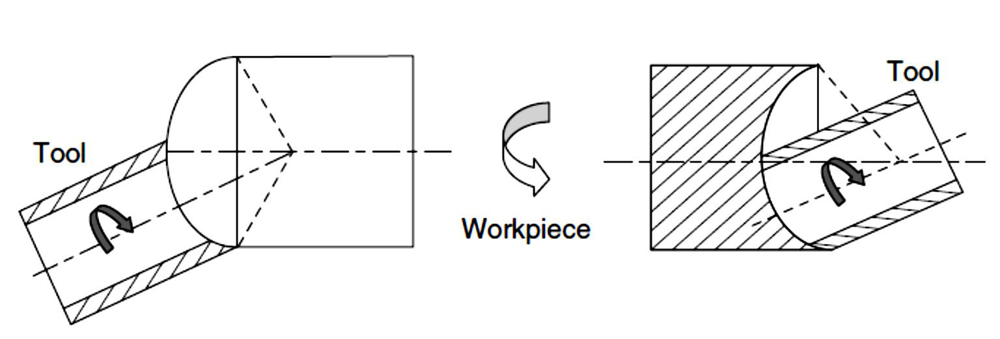
Rotary EDM

Slide 63
Machining of dies and molds. EDM milling uses standard cylindrical electrodes. Complex cavities aremachined by successive NC sweeps of the electrode down to the desired depth. The simple-shaped electrode is rotated at high speeds and follows specified paths in the workpiece like the conventional end mills. This technique is very useful and makes EDM very versatile like the mechanical milling process. The process solves the problem of manufacturing accurate and complex-shaped electrodes for die sinking of three-dimensional cavities shown in Fig9. EDM milling enhances dielectric flushing due to the high-speed electrode rotation. The electrode wear can be optimized because of the rotational and contouring motions of the electrode. The main limitation in the EDM milling is that complex shapes with sharp corners cannot be

Slide 64
machined because of the rotating tool electrode. Figure shows the flowchart of the die sinking process.EDM milling also replaces the conventional die making that requires the use of a variety of machines suchas milling, wire cutting, and EDM die sinking machines.

Slide 65
DRILLING MACHINE
Introduction:
The drilling machine or drill press is one of the most common and useful machine employed inindustry for producing forming and finishing holes in a workpiece. The unit essentially consists of:
1. A spindle which turns the tool (called drill) which can be advanced in the workpiece either automatically orby hand.
2. A work table which holds the workpiece rigidly in position.

Slide 66
Working principle: The rotating edge of the drill exerts a large force on the workpiece and the hole is generated. The removal of metal in a drilling operation is by shearing and extrusion.

Slide 67
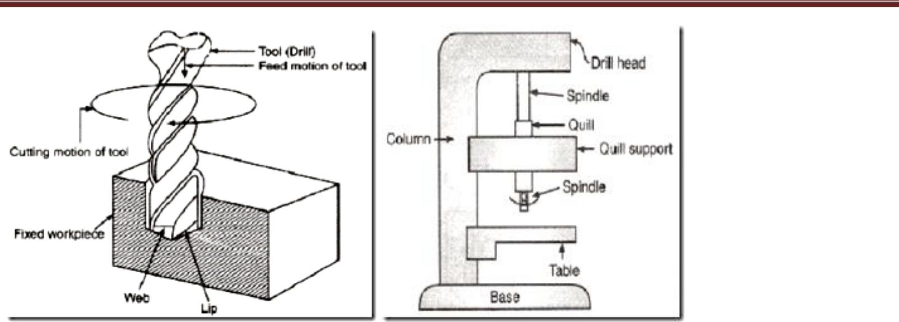

Slide 68
Types of Drilling Machines: A wide variety of drilling machines are available ranging from the simple portable to highly complex automatic and numerically controlled machines are as follows:
1. Portable drilling machine: It is a small light weight, compact and self contained unit that can drill holes upto 12.5 rnrn diameter. The machine is driven by a small electric motor operating at high speed. The machine is capable of drilling holes in the workpieces in any position.

Slide 69
2. Sensitive drill machine/press: This is a light weight, high speed machine designed for drilling small holes in light jobs. Generally the machine has the capacity to rotate drills of 1.5 to 15.5 rnrn at high speed of 20,000 rev/min.

Slide 70
Construction:
The machine has only a hand feed mechanism for feeding the tool into the workpiece.
This
enables the operator to feel how the drill is cutting and accordingly he can control the down feed pressure.
Sensitive drill presses are manufactured in bench or floor models, i.e., the base of machine may be mounted
on a bench or floor.
The main operating parts of a sensitive machine/drill press are Base, Column, Table, and Drill Head.

Slide 71
1. Base: The base is a heavy casting that supports the machine structure; it provides rigid mounting for the column and stability for the machine. The base is usually provided with holes and slots which help to Bolt the base to a table or bench and allow the work-holding device or the workpiece to be fastened to the base.
2. Column: The column is a vertical post that Column holds the worktable and the head containing the driving mechanism. The column may be of round or box section.
3. Table: The table, either rectangular or round. Drill machine/press in shape supports the workpiece and is carried by the vertical column. The surface of the table is 90-degree to the column and it can be raised, lowered and swiveled around it. The table can be clamp/hold the required the workpiece. Slots are provided in
most tables to allow the jigs, fixtures or large workpieces to be securely fixed directly to the table.
4. Drilling Head: The drilling head, mounted close to the top of the column, houses the driving arrangementand variable speed pulleys. These units transmit rotary motion at different speeds to the drill spindle. The hand feed lever is used to control the vertical movement of the spindle sleeve and the cutting tool.

Slide 72
SHAPER MACHINE

Slide 73
SHAPER MACHINE
Working Principle: The job is rigidly fixed on the machine table. The single point cutting tool held properly
Introduction: The shaper is a machine tool used primarily for:
1. Producing a flat or plane surface which may be in a horizontal, a vertical or an angular plane.
2. Making slots, grooves and keyways
3. Producing contour of concave/convex or a combination of these
in the tool post is mounted on a reciprocating ram. The reciprocating motion of the ram is obtained by a quickreturn motion mechanism. As the ram reciprocates, the tool cuts the material during its forward stroke. During return, there is no cutting action and this stroke is called the idle stroke. The forward and return strokes constitute one operating cycle of the shaper.

Slide 74
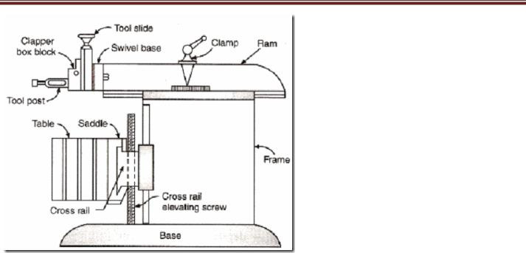
Construction: The main parts of the Shaper machine is Base, Body (Pillar, Frame, Column), Cross rail, Ram
and tool head (Tool Post, Tool Slide, Clamper Box Block).

Slide 76
Base: The base is a heavy cast iron casting which is fixed to the shop floor. It supports the body frame and theentire load of the machine. The base absorbs and withstands vibrations and other forces which are likely to be induced during the shaping operations.
Body (Pillar, Frame, Column): It is mounted on the base and houses the drive mechanism compressing the main drives, the gear box and the quick return mechanism for the ram movement. The top of the body provides guide ways for the ram and its front provides the guide ways for the cross rail.
Cross rail: The cross rail is mounted on the front of the body frame and can be moved up and down. The vertical movement of the cross rail permits jobs of different heights to be accommodated below the tool. Sliding along the cross rail is a saddle which carries the work table.
Ram and tool head: The ram is driven back and forth in its slides by the slotted link mechanism. The backand forth movement of ram is called stroke and it can be adjusted according to the length of the workpiece to be-machined.

Slide 77
LATHE MACHINE
Working Principle: The lathe is a machine tool which holds the workpiece between two rigid and strong supports called centers or in a chuck or face plate which revolves. The cutting tool is rigidly held and supported in a tool post which is fed against the revolving work. The normal cutting operations are performed with the cutting tool fed either parallel or at right angles to the axis of the work.

Slide 78
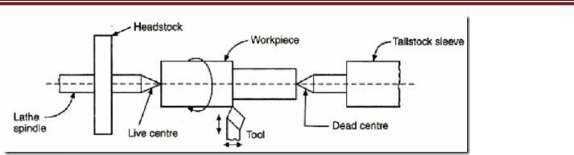

Slide 79
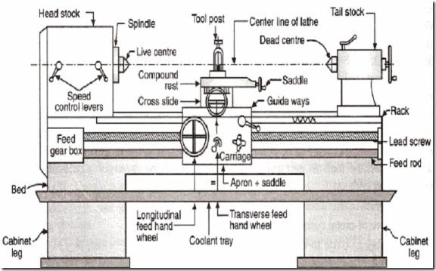
Construction: The main parts of the lathe are the bed, headstock, quick changing gear box, carriage and tailstock.

Slide 80
2. Legs: The legs carry the entire load of machine and are firmly secured to floor by foundation bolts.
3. Headstock: The headstock is clamped on the left hand side of the bed and it serves as housing for the driving pulleys, back gears, headstock spindle, live centre and the feed reverse gear. The headstock spindle is a hollow cylindrical shaft that provides a drive from the motor to work holding devices.
4. Gear Box: The quick-change gear-box is placed below the headstock and contains a number of different sized gears.
5. Carriage: The carriage is located between the headstock and tailstock and serves the purpose of supporting, guiding and feeding the tool against the job during operation. The main parts of carriage are:a). The saddle is an H-shaped casting mounted on the top of lathe ways. It provides support to cross-slide,compound rest and tool post.

Slide 81
b). The cross slide is mounted on the top of saddle, and it provides a mounted or automatic cross movement for the cutting tool.
c). The compound rest is fitted on the top of cross slide and is used to support the tool post and the cutting tool.
d). The tool post is mounted on the compound rest, and it rigidly clamps the cutting tool or tool holder at the proper height relative to the work centre line.
e). The apron is fastened to the saddle and it houses the gears, clutches and levers required to move the carriage or cross slide. The engagement of split nut lever and the automatic feed lever at the same time is prevented she carriage along the lathe bed.
6. Tailstock: The tailstock is a movable casting located opposite the headstock on the ways of the bed. The tailstock can slide along the bed to accommodate different lengths of workpiece between the centers. A tailstock clamp is provided to lock the tailstock at any desired position. The tailstock spindle has an internal taper to hold the dead centre and the tapered shank tools such as reamers and drills.

Slide 82
LATHE OPERATIONS
The engine lathe is an accurate and versatile machine on which many operations can be performed. These
operations are:
1. Plain Turning and Step Turning
2. Facing
3. Parting
4. Drilling
5. Reaming
6. Boring
7. Knurling
8. Grooving
9. Threading
10. Forming

Slide 83
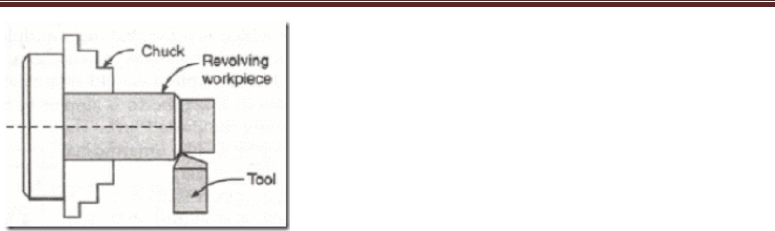
1. Plain Turning: Plain turning is the operation of removing excess amount of material from the surface of a cylindrical job.

Slide 84
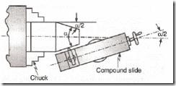
Taper Turning: The taper turning is an operation of producing a conical surface by gradual reduction in the
diameter of a cylindrical workpiece.

Slide 85
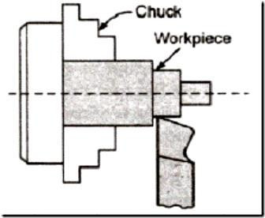
1. Step Turning: Step turning produces various steps of different diameters. Forming:

Slide 86
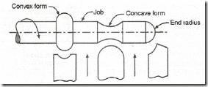
Forming: The forming is an operation that produces a convex, concave or any irregular profile on the workpiece.

Slide 87
Filing and Polishing: The filing is the finishing operation that removes burrs, sharp corners and feed marks from the workpiece . After filing, the surface quality is the workpiece is improved by the polishing operation with the help of emery cloth of fine grades.
Chamfering: Chamfering removes the burrs and sharp edges, and thus makes the handling safe. Chamfering can be done by a form tool having angle equal to chamfer which is generally kept at 45°.

Slide 88
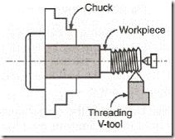
Threading: Threading is the act of cutting of the required form of threads on the internal or external c ylindrical surfaces.

Slide 89
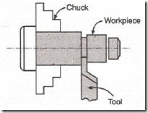
Grooving: Grooving is the act of making grooves of reduced diameter in the workpiece.

Slide 90
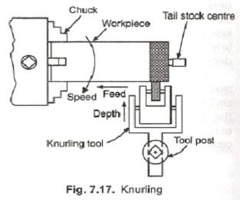
Knurling: The knurling is a process of embossing (impressing) a diamond-shaped or straight-line pattern into the surface of workpiece. Knurling is essentially a roughening of the surface and is done to provide a better gripping surface.

Slide 91
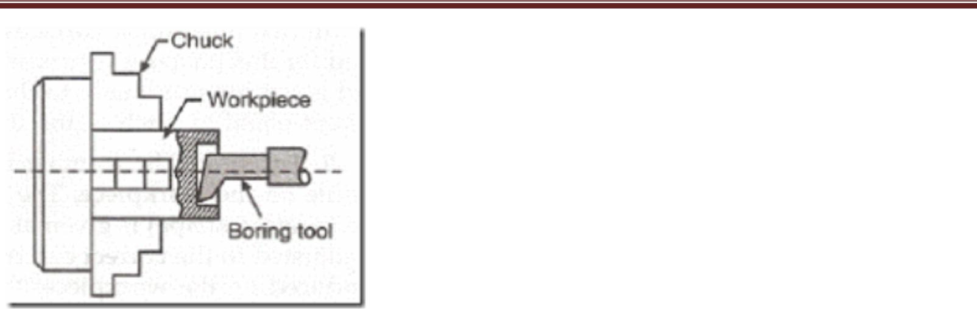
Boring: The boring operation is the process of enlarging a hole already produced by drilling.

Slide 92
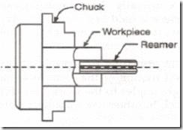
Reaming: The holes that are produced by drilling are rarely straight and cylindrical in form. The reaming operation finishes and sizes the hole already drilled into the workpiece.

Slide 93
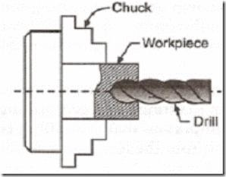
. Drilling: Drilling is the operation of producing a cylindrical hole in the workpiece.

Slide 94
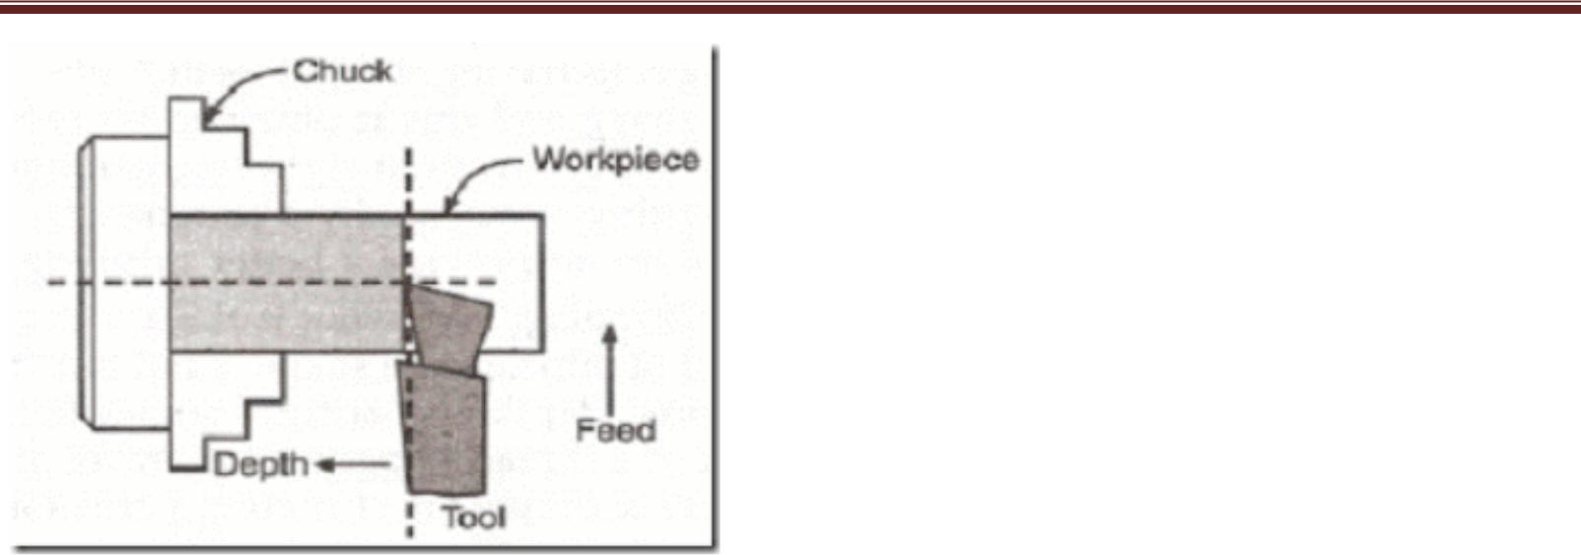
Parting: The parting or cutting off is the operation of cutting away a desired length of the workpiece, i.e., dividing the workpiece in two or more parts.

Slide 95
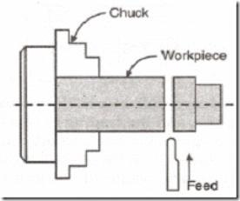
Facing: The facing is a machining operation by which the end surface of the work piece is made flat by removing metal from it.

Slide 96
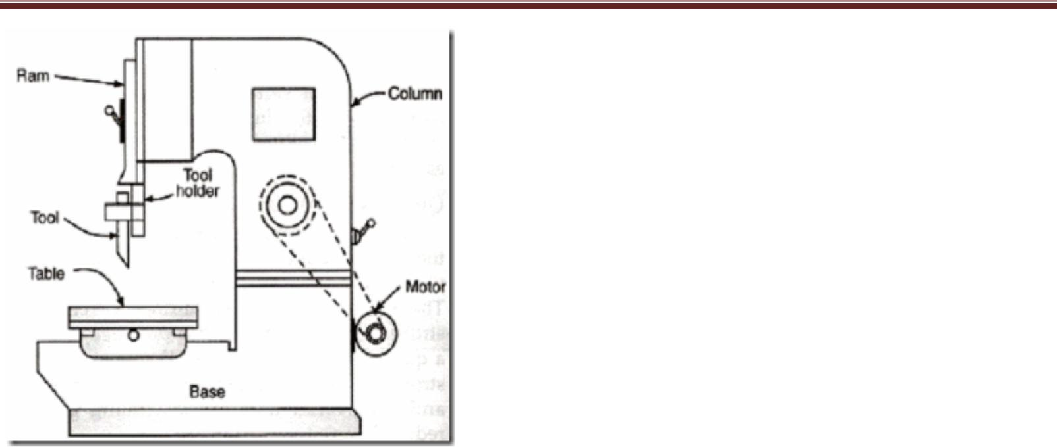
SLOTTING MACHINE
Introduction: The slotting machine is a reciprocating machine tool in which, the ram holding the tool reciprocates in a vertical axis and the cutting action of the tool is only during the downward stroke.
Construction: The slotter can be considered as a vertical shaper and its main parts are:
1. Base, column and table
2. Ram and tool head assembly
3. Saddle and cross slide
4 . Ram drive mechanism and feed mechanism.

Slide 97
The base of the slotting machine is rigidly built to take up all the cutting forces. The front face of the vertical column has guide ways for Tool the reciprocating ram. The ram supports the tool head to which the tool is attached. The workpiece is mounted on the table which can be given longitudinal, cross and rotary feedmotion.
The slotting machine is used for cutting grooves, keys and slotes of various shapes making regular and irregular surfaces both internal and external cutting internal and external gears and profiles The slotter machine can be used on any type of work where vertical tool movement is considered essential and advantageous.
The different types of slotting machines are:
1. Punch slotter: a heavy duty rigid machine designed for removing large amount of metal from large forgings or castings
2. Tool room slotter: a heavy machine which is designed to operate at high speeds. This machine takes light cuts and gives accurate finishing.
3. Production slotter: a heavy duty slotter consisting of heavy cast base and heavy frame, and is generally made in two parts.

Slide 98
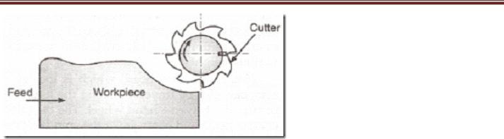
MILLING MACHINE
Introduction: Milling is the cutting operation that removes metal by feeding the work against a rotating, cutter having single or multiple cutting edges. Flat or curved surfaces of many shapes can be machined by milling with good finish and accuracy. A milling machine may also be used for drilling, slotting, making a circular profile and gear cutting by having suitable attachments.
Working Principle: The workpiece is holding on the worktable of the machine. The table movement controls the feed of workpiece against the rotating cutter. The cutter is mounted on a spindle or arbor and revolves at high speed. Except for rotation the cutter has no other motion. As the workpiece advances, the cutter teethremove the metal from the surface of workpiece and the desired shape is produced. Prepared By

Slide 99
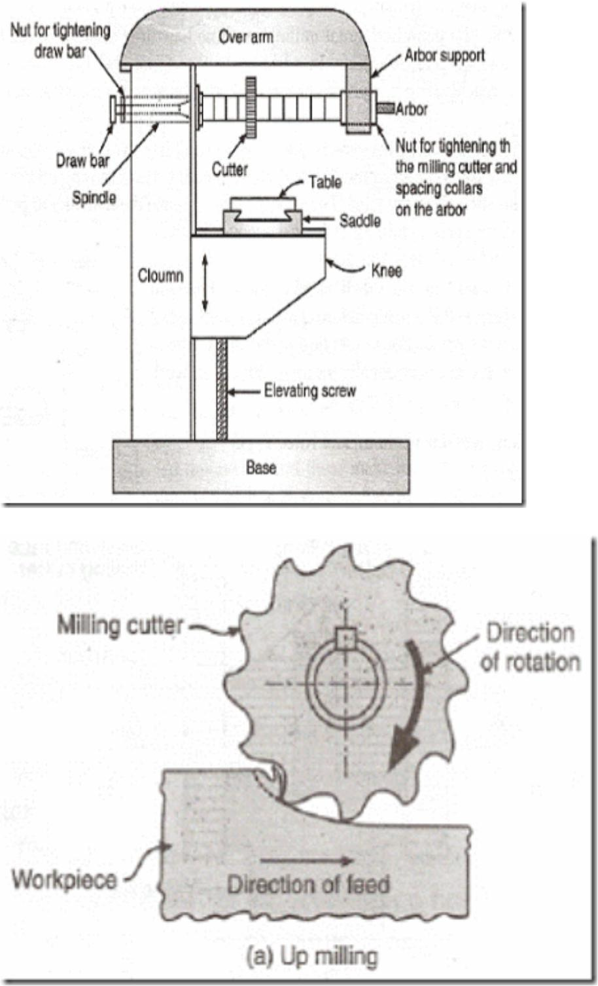
Horizontal Milling Machine Construction: The main part of machine is base, Column, Knee, Saddle, Table, Overarm, Arbor Support and Elevating Screw.

Slide 100
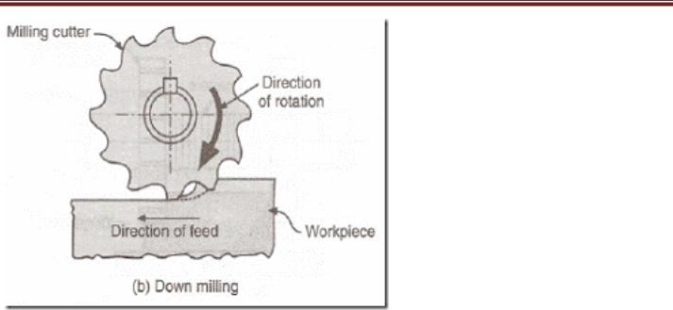
1. Base: It gives support and rigidity to the machine and also acts as a reservoir for the cutting fluids.
2. Column: The column is the main supporting frame mounted vertically on the base. The column is box shaped, heavily ribbed inside and houses all the driving mechanisms for the spindle and table feed.
3. Knee: The knee is a rigid casting mounted on the front face of the column. The knee moves vertically along the guide ways and this movement enables to adjust the distance between the cutter and the job mounted on the table. The adjustment is obtained manually or automatically by operating the elevating screw provided below the knee.
4. Saddle: The saddle rests on the knee and constitutes the intermediate part between the knee and the table.The saddle moves transversely, i.e., crosswise (in or out) on guide ways provided on the knee.

